Slide 1
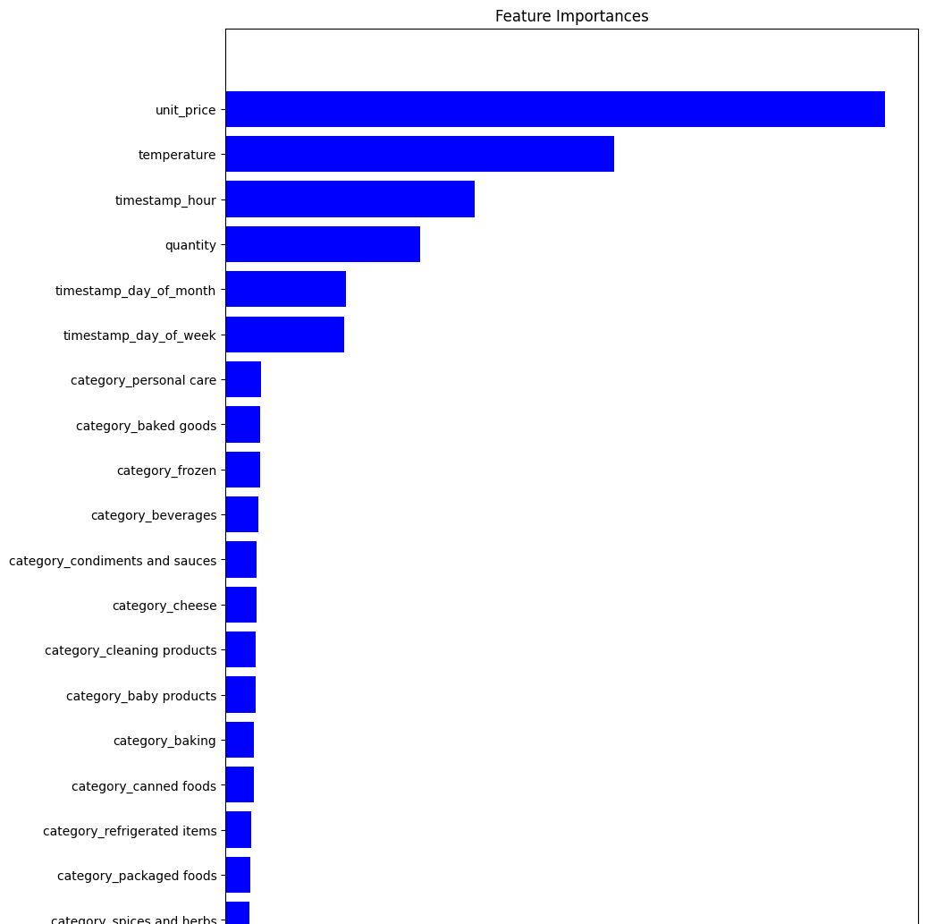
Relative importance of features
Unit Price was an important in the model, but category was not. Are there more features about products that we can use to include in the model?
The current set of data and features produced approximately 50% accuracy. A large dataset is necessary to evaluate this model for production

